Slide 1

NEUB Restaurant System
MD Muradul Islam polash
Id:0562310005101006
ARNOB DAS
ID: 0562310005101028

Slide 2


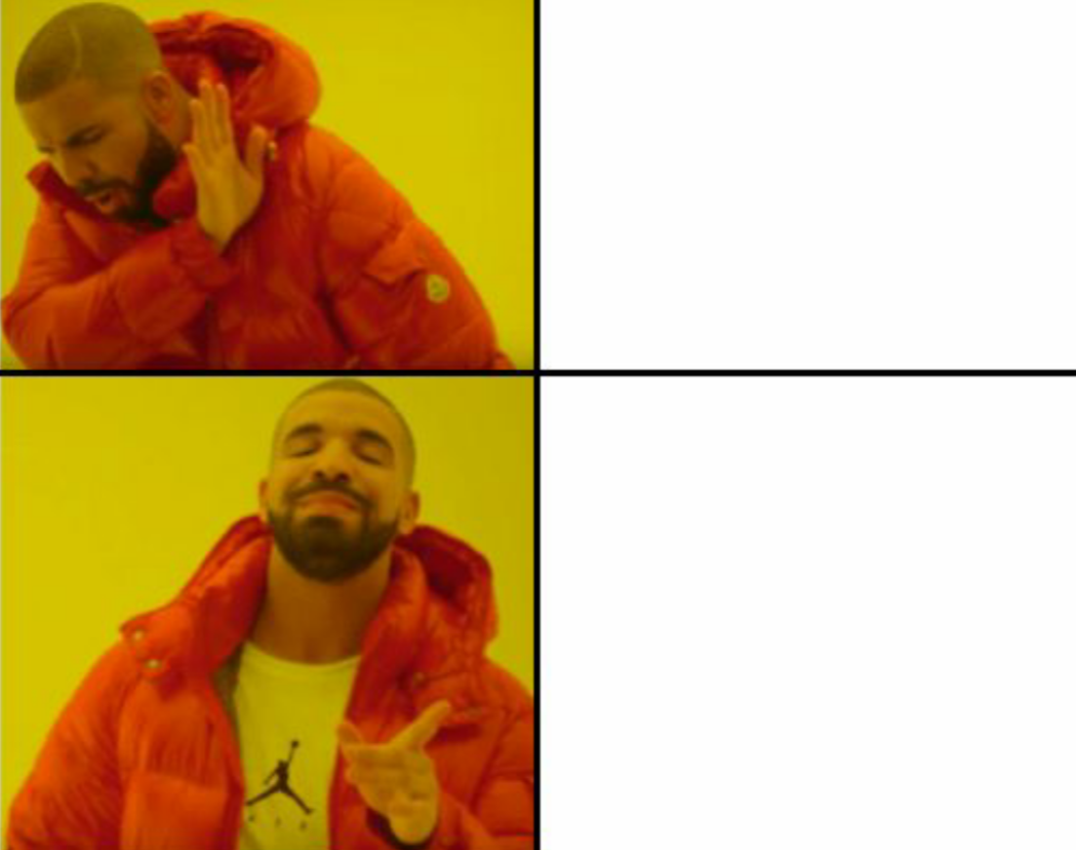

MOTIVATION
A digital Modern web solution for typical analog note leisure book to a web system.
For 21st century, this project is very helpful for maintain lite business to convert a digital and Hassle free management.

Slide 3

USED LANGUAGE :
FrontEND: CSS & JAVASCRIPT
BackEND: PHP
Database: MySQL

Slide 4
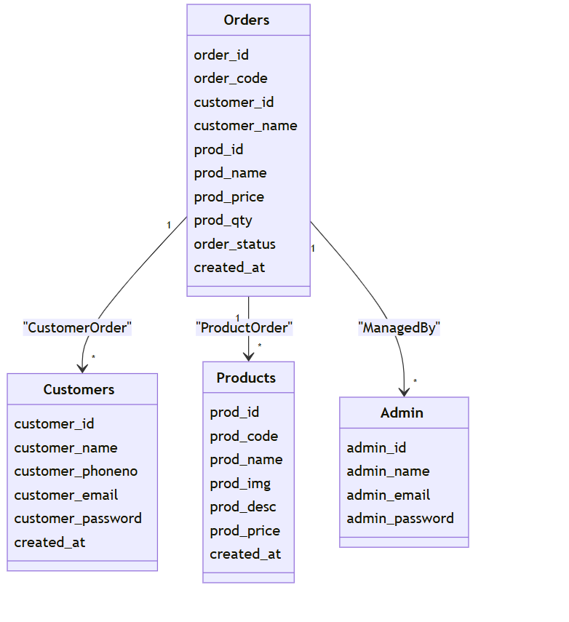
DIAGRAM
Database ER Diagram for this project

Slide 5
Work flow
ADMIN
FrontEND
BackEND
Database
Customer
FrontEND
BackEND
Database

Slide 6
Included feature
Customer
Can order food and Get previous Record.
Admin
Can access and maintain shop easily.
Developer
For easy to use, project is updateable and can add other features.

Slide 7

Thank you
MD Muradul Islam polash
ARNOB DAS

